Slide 1
Virtual Machine Provisioning and Migration Services
Unit-7

Slide 2
5.1 Introduction
Cloud Computing – Builds on achievements on research areas like SOA, grid computing and virtualization technology
It provides IAAS – based on pay as you use and on-demand computing models to end users.
To provide this service- provisioning of cloud infrastructure in data centers are prerequisite.
This chapter focus on the core services that enable users to get best out of IaaS model in public and private cloud setups.

Slide 3
5.2.1 Virtualization Technology Overview
Virtualization has revolutionized data center’s technology through a set of techniques and tools that facilitate the providing and management of the dynamic data center’s infrastructure.
Virtualization can be defined as the abstraction of the four computing resources (storage, processing power, memory, and network or I/O).
It is conceptually similar to
Emulation - where a system pretends to be another system,
virtualization - a system pretending to be two or more of the same system .
Virtualization layer will partition the physical resource of the underlying physical server into multiple virtual machines with different workloads.
VM schedules, allocates the physical resource, and makes each virtual machine think that it totally owns the whole underlying hardware’s physical resource (processor, disks, rams, etc.)

Slide 4
Virtual machine’s technology makes it very flexible and easy to manage resources in cloud computing environments, because they improve the utilization of such resources by multiplexing many virtual machines on one physical host (server consolidation).
Virtualization enables
→high, reliable, and agile deployment mechanisms
management of services,
providing on-demand cloning and live migration services which improve reliability.

Slide 5
5.2.2 Public Cloud and Infrastructure Services
Here resources are dynamically provisioned via publicly accessible Web applications/Web services (SOAP or RESTful interfaces) from an off-site third-party provider.
The user pays only for the capacity of the provisioned resources at a particular time.
Vendors publicly provide infrastructure as a service.
Eg, Amazon Elastic Compute Cloud (EC2) , GoGrid, AppNexus , FlexiScale , Manjrasoft ,Aneka etc

Slide 6
Amazon Elastic Compute Cloud (EC2) is an IaaS service that provides elastic compute capacity in the cloud.
These services can be leveraged via Web services (SOAP or REST), a Web-based AWS (Amazon Web Service) management console, or the EC2 command line tools.
The Amazon service provides variety of operating systems (i.e., Linux, OpenSolaris, or Windows) and pre-loaded software.
Amazon offers different instances’ size according to
(a) the resources’ needs
(b) the high CPU’s needs it provides
(c) high-memory instances

Slide 7
5.2.3 Private Cloud and Infrastructure Services
A private cloud aims at providing public cloud functionality, but on private resources.
Private cloud exhibits a highly virtualized cloud data center located inside organization’s firewall.
Private clouds exhibit the following characteristics:
Allow service provisioning and compute capability for an organization’s users in a self-service manner.
Automate and provide well-managed virtualized environments.
Optimize computing resources, and servers’ utilization.
Support specific workloads.

Slide 8
Vendors and frameworks that provide infrastructure as a service in private setups. Eg. Eucalyptus and OpenNebula
The third type of cloud setup named “hybrid cloud,” in which a combination of private/internal and external cloud resources exist together by enabling outsourcing of noncritical services and functions in public cloud and keeping the critical ones internal.
Hybrid cloud’s main function is to release resources from a public cloud and to handle sudden demand usage, which is called “cloud bursting.”

Slide 9
5.2.4 Distributed Management of Virtualization
Many commercial, open source products and research projects such as OpenNebula , IBM Virtualization Manager and VMware are being developed to dynamically provision virtual machines, utilizing the physical infrastructure.
There are also some commercial and scientific infrastructure cloud computing initiatives, such as Globus VWS, Eucalyptus and Amazon, which provide remote interfaces for controlling and monitoring virtual resources.
RESERVOIR initiative, in which grid interfaces and protocols enable the required interoperability between the clouds or infrastructure’s providers.

Slide 10
5.2.5 High Availability
High availability is a system design protocol and an associated implementation that ensures a certain absolute degree of operational continuity during a given period.
Availability refers to the ability of a user’s community to access the system—whether for submiting new work, updating or altering existing work, or collecting the results of the previous work. If a user cannot access the system, it is said to be unavailable.
This means that services should be available all the time along with some planned/unplanned downtime according to a certain SLA.
High availability allows virtual machines to automatically be restarted in case of an underlying hardware failure or individual VM failure.
If one of your servers fails, the VMs will be restarted on other virtualized servers in the resource pool, restoring the essential services with minimal service interruption

Slide 11
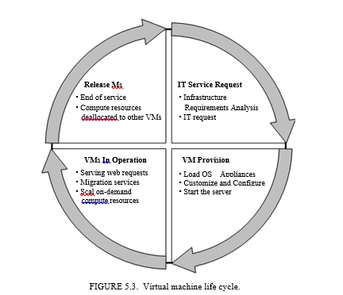
5.3 VIRTUAL MACHINES PROVISIONING AND MANAGEABILITY
The cycle starts by a request delivered to the IT department, stating the requirement for creating a new server for a particular service.
This request is being processed by the IT administration to start seeing the servers’ resource pool, matching these resources with the requirements, and starting the provision of the needed virtual machine.
Once it is provisioned and started, it is ready to provide the required service according to an SLA, or a time period after which the virtual is being released.
4
1
3
2

Slide 12
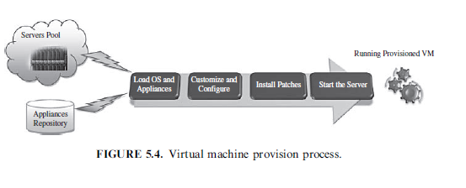
5.3.1 VM Provisioning Process

Slide 13
5.3.1 VM Provisioning Process
Steps to Provision VM:
Firstly, we need to select a server from a pool of available servers along with the appropriate OS template we need to provision the virtual machine.
Secondly, we need to load the appropriate software (operating system, device drivers, middleware, and the needed applications for the service required).
Thirdly, we need to customize and configure the machine (e.g., IP address, Gateway) to configure an associated network and storage resources.
Finally, the virtual server is ready to start with its newly loaded software.

Slide 14
To summarize, server provisioning is defining server’s configuration based on
the organization requirements, a hardware, and software component (processor, RAM, storage, networking, operating system, applications, etc.).
Normally, virtual machines can be provisioned by manually installing an operating system, by using a preconfigured VM template, by cloning an existing VM, or by importing a physical server or a virtual server from another hosting platform.

Slide 15
5.4 VIRTUAL MACHINE MIGRATION SERVICES
Migration service, in the context of virtual machines, is the process of moving a virtual machine from one host server or storage location to another.
There are different techniques of VM migration,
hot/real time migration
cold/regular migration
live storage migration
In this process, all key machines’ components, such as CPU, storage disks, networking, and memory, are completely virtualized, thereby facilitating the entire state of a virtual machine to be captured by a set of easily moved data files.

Slide 16
5.4.1 Migrations Techniques
Live Migration and High Availability:
Live migration (which is also called hot or real-time migration) can be defined as the movement of a virtual machine from one physical host to another while being powered on.
When it is properly carried out, this process takes place without any noticeable effect from the end user’s point of view (a matter of milliseconds).
One of the most significant advantages of live migration is the fact that it facilitates proactive maintenance in case of failure, because the potential problem can be resolved before the disruption of service occurs.
Live migration can also be used for load balancing in which work is shared among computers in order to optimize the utilization of available CPU resources.

Slide 17
Cold migration or Regular Migration:
Cold migration is the migration of a powered-off virtual machine.
With cold migration, we have the option of moving the associated disks from one data store to another.
The virtual machines are not required to be on a shared storage.
It’s important to highlight that the two main differences between live migration and cold migration are …
Live migration needs a shared storage for virtual machines in the server’s pool but cold migration shared storage is not required.
In live migration for a virtual machine between two hosts, there would be certain CPU compatibility checks to be applied while in cold migration this checks do not apply.

Slide 18
Live Storage Migration :
Live storage migration of Virtual Machine constitutes
moving the virtual disks or configuration file of a running virtual machine to a new data store without any interruption in the availability of the virtual machine’s service.

Slide 19
The migration process has been viewed as a transactional interaction between the two hosts involved:
Stage 0: Pre-Migration. An active virtual machine exists on the physical host A.
Stage 1: Reservation. A request is issued to migrate an OS from host A to host B (a precondition is that the necessary resources exist on B and on a VM container of that size).
Stage 2: Iterative Pre-Copy. During the first iteration, all pages are transferred from A to B. Subsequent iterations copy only those pages dirtied during the previous transfer phase.
Stage 3: Stop-and-Copy. Running OS instance at A is suspended, and its network traffic is redirected to B. CPU state and any remaining inconsistent memory pages are then transferred. At the end of this stage, there is a consistent suspended copy of the VM at both A and B. The copy at A is considered primary and is resumed in case of failure.

Slide 20
Stage 4: Commitment. Host B indicates to A that it has successfully received a consistent OS image. Host A acknowledges this message as a commitment of the migration transaction. Host A may now discard the original VM, and host B becomes the primary host.
Stage 5: Activation. The migrated VM on B is now activated. Post-migration code runs to reattach the device’s drivers to the new machine and advertise moved IP addresses.

Slide 21
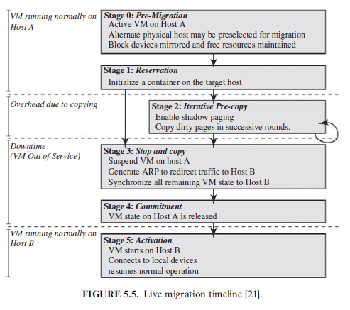

Slide 22
5.6 PROVISIONING IN THE CLOUD CONTEXT
virtual machine provisioning and migration services:
Amazon EC2 is a widely known example for vendors that provide public cloud services.
Eucalyptus and OpenNebula are two complementary and enabling technologies for open source cloud tools, which play an invaluable role in infrastructure as a service and in building private, public, and hybrid cloud architecture.
Eucalyptus is a system for implementing on-premise private and hybrid clouds using the hardware and software’s infrastructure, which is in place without modification.
Eucalyptus is implemented using commonly available Linux tools and basic Web service’s technologies .
Eucalyptus adds capabilities, such as end-user customization, self-service provisioning, and legacy application support to data center’s virtualization’s features, making the IT customer’s service easier .
Open Nebula is a infrastructure manager that orchestrates storage, network, and virtualization technologies to enable the dynamic placement of multi-tier services on distributed infrastructures, combining both data center’s resources and remote cloud’s resources

Slide 23
5.6.1 Amazon Elastic Compute Cloud
The Amazon EC2 (Elastic Compute Cloud) is a Web service that allows users to provision new machines into Amazon’s virtualized infrastructure using a publicly available API and it reduces the time required to obtain and boot a new server.
Users get full root access and can install almost any OS or application in their AMIs (Amazon Machine Images).
Web services APIs allow users to reboot their instances remotely, scale capacity quickly, and use on-demand service when needed
EC2 instance is a virtual machine with a certain amount of RAM, CPU, and storage capacity. Setting up an EC2 instance is quite easy. Once we create your AWS (Amazon Web service) account, we can use the on-line AWS console, or simply download the offline command line’s tools to start provisioning your instances.

Slide 24
Amazon EC2 provides its customers with three flexible purchasing models :
On-Demand instances, which allow you to pay a fixed rate by the hour with no commitment.
Reserved instances, which allow you to pay a low, one-time fee and in turn receive a significant discount on the hourly usage charge for that instance.
Spot instances, which enable you to bid whatever price you want for instance capacity, providing for even greater savings, if your applications have flexible start and end times.

Slide 25
Amazon and Provisioning Services:
Amazon provides an excellent set of tools that help in provisioning service.
Amazon Auto Scaling is a set of command line tools that allows scaling Amazon EC2 capacity up or down automatically and according to the conditions the end user defines.
This feature ensures that the number of Amazon EC2 instances can scale up seamlessly during demand spikes to maintain performance and can scale down automatically when loads diminish and become less intensive to minimize the costs.
Auto Scaling service and CloudWatch (a monitoring service for AWS cloud resources and their utilization) help in exposing functionalities required for provisioning application services on Amazon EC2.
Amazon Elastic Load Balancer is another service that helps in building fault-tolerant applications by automatically provisioning incoming application workload across available Amazon EC2 instances and in multiple availability zones.

